Slide 1
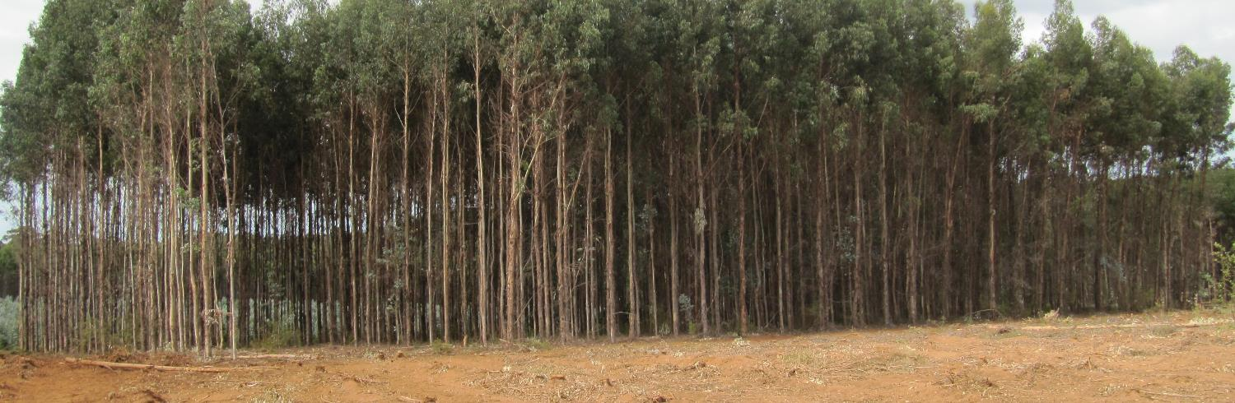
Capturing the value of residues – on site or off site?
Image credit: John Wiedemann
Daniel Mendham, Sadanandan Nambiar, Philip Smethurst
CSIRO Environment
Notes:
1

Slide 2
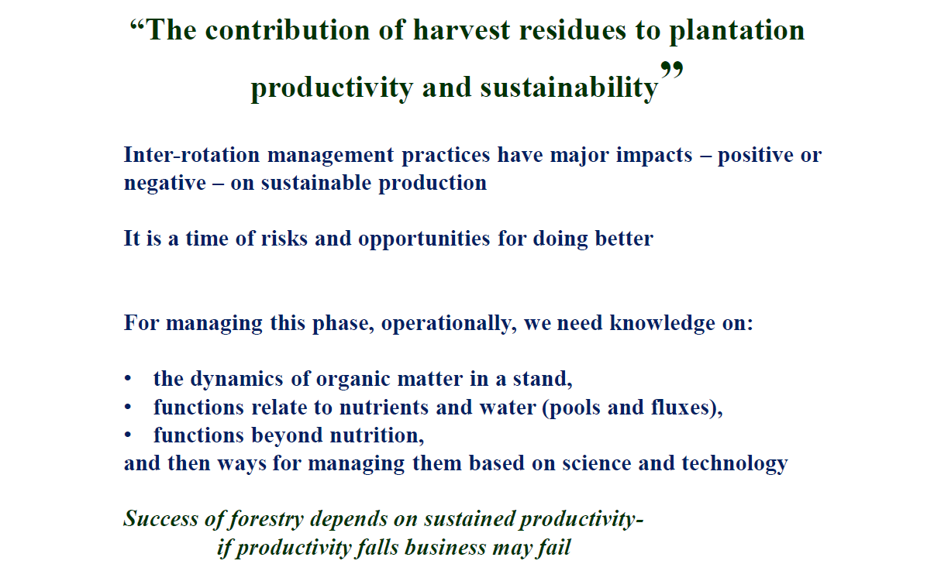
Notes:
2

Slide 3
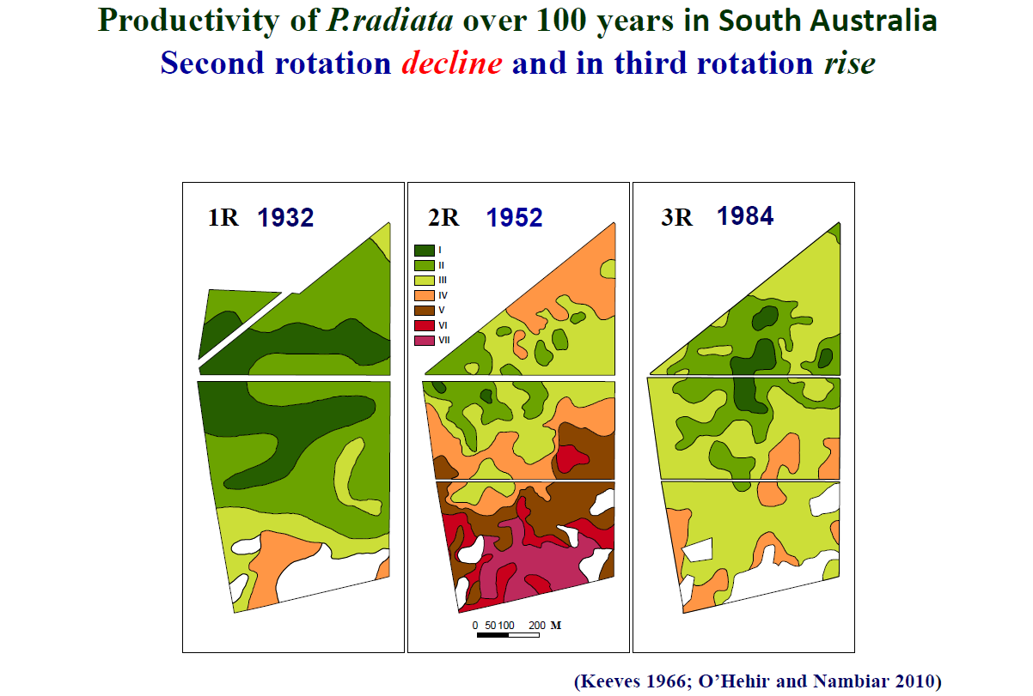
Notes:
3

Slide 4
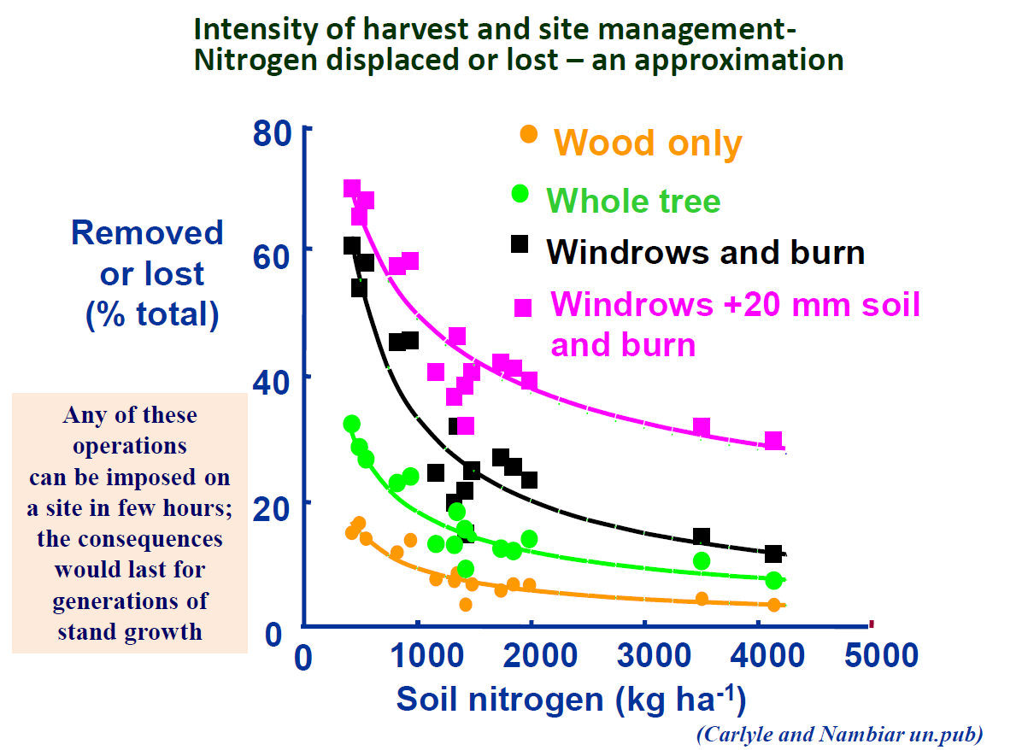
Notes:
4

Slide 5
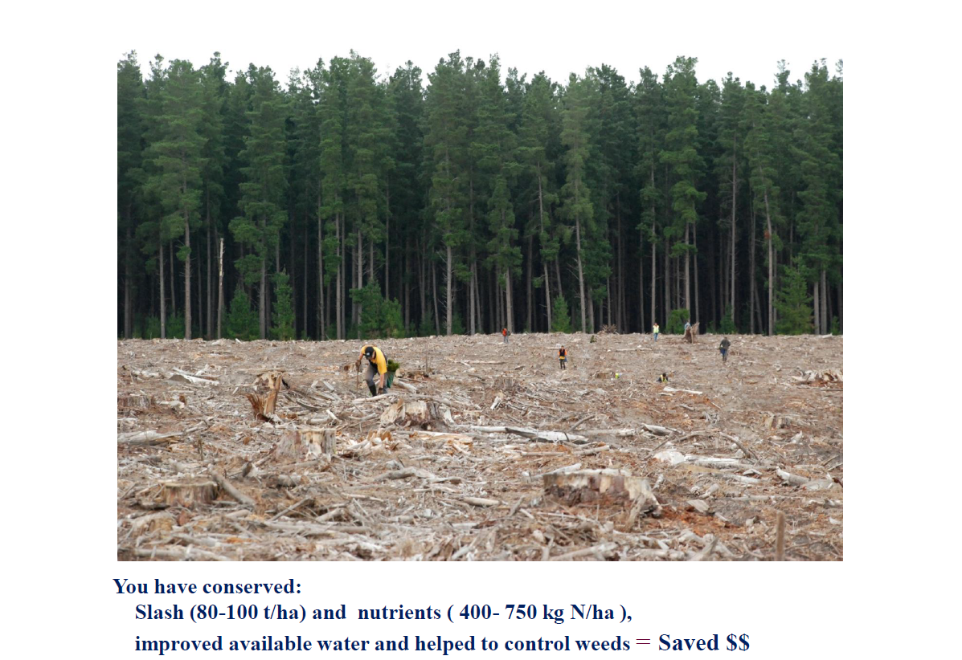
Notes:
5

Slide 6
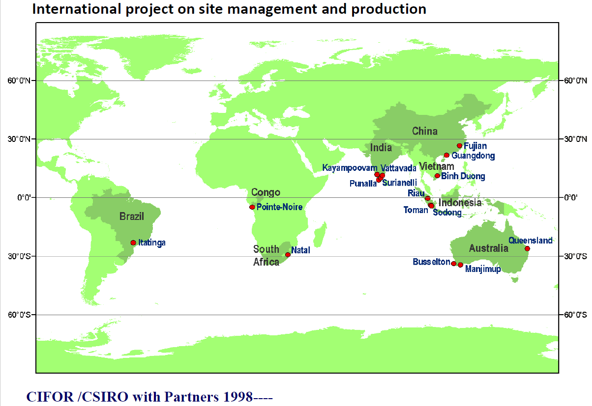
Notes:
6

Slide 7
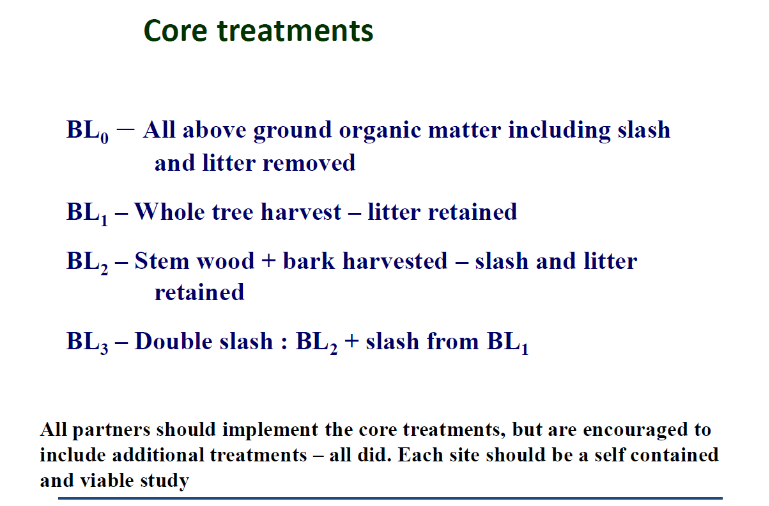
Notes:
7

Slide 8
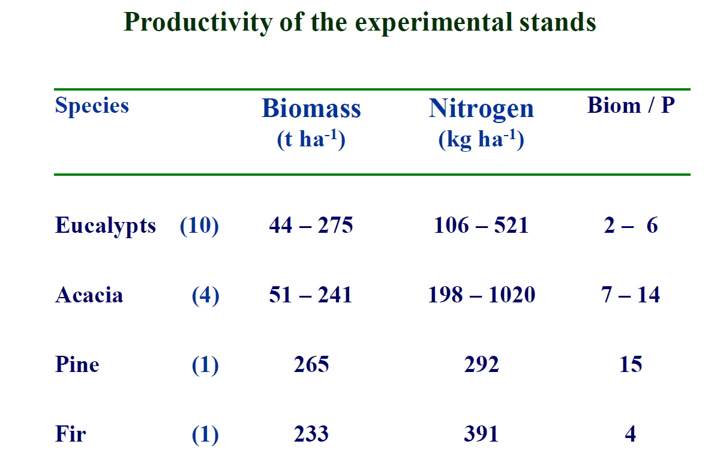
Notes:
8

Slide 9
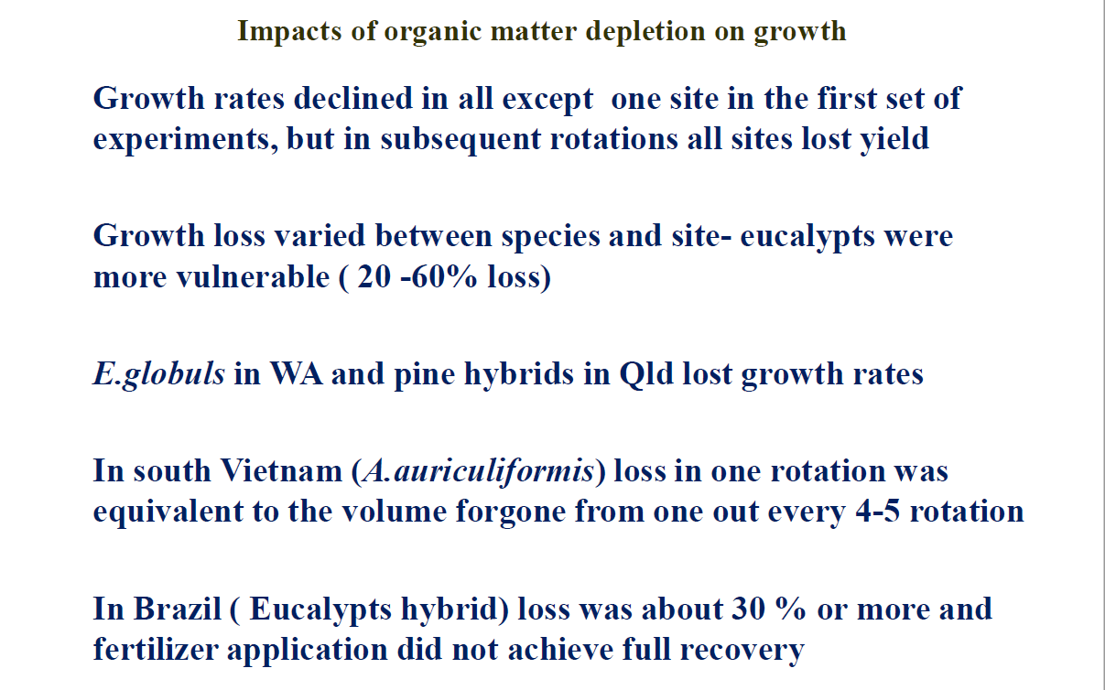
Notes:
9

Slide 10
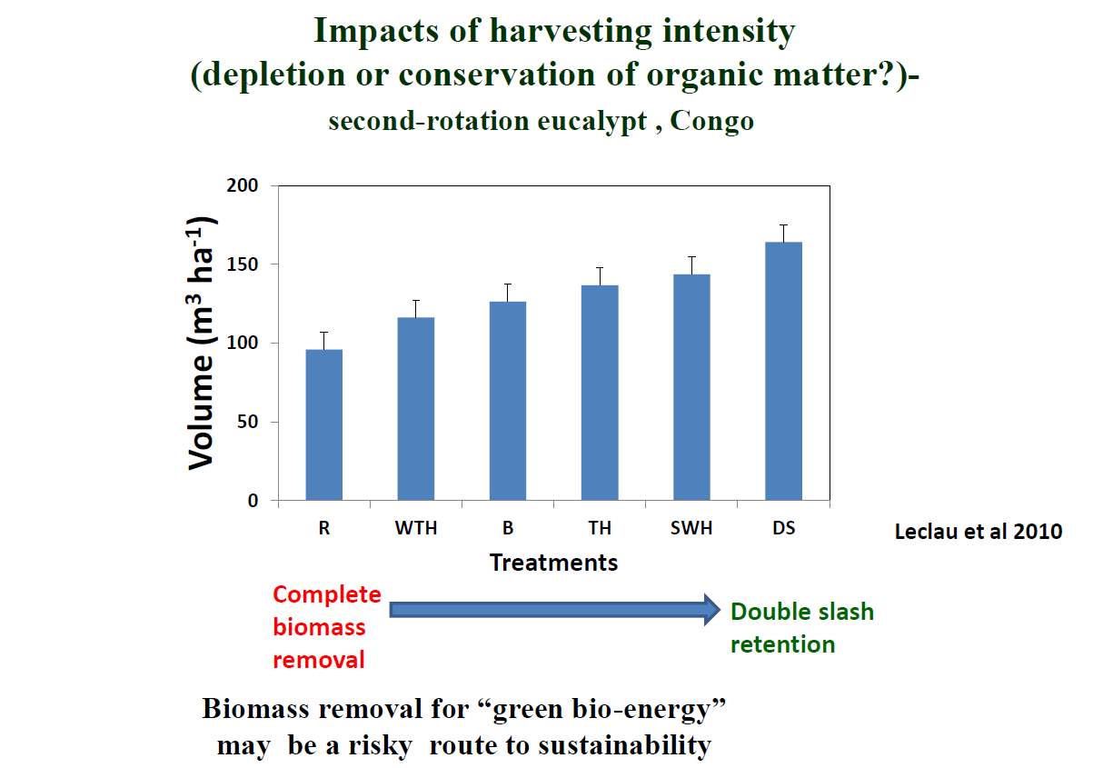
Notes:
10

Slide 11
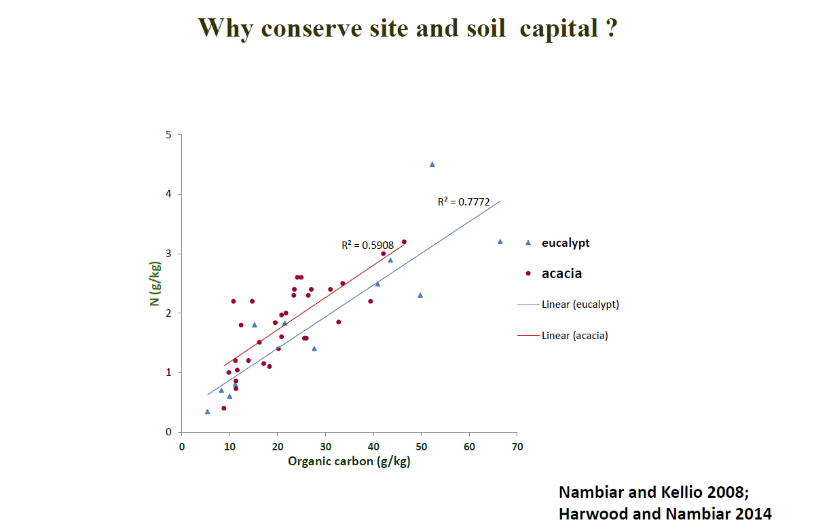
Notes:
11

Slide 12
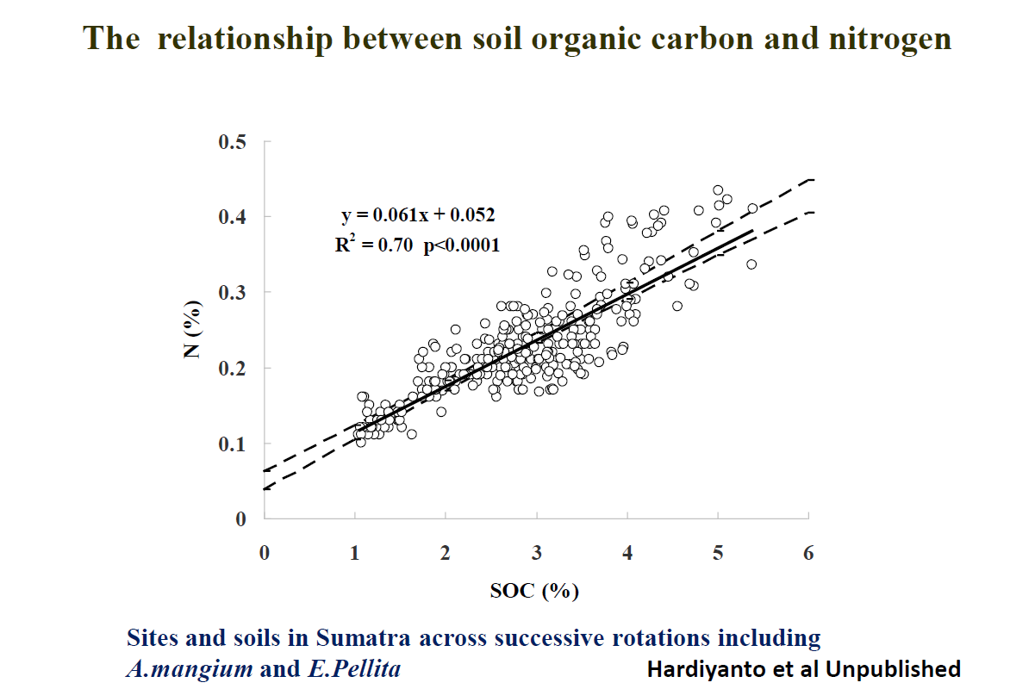
Notes:
12

Slide 13
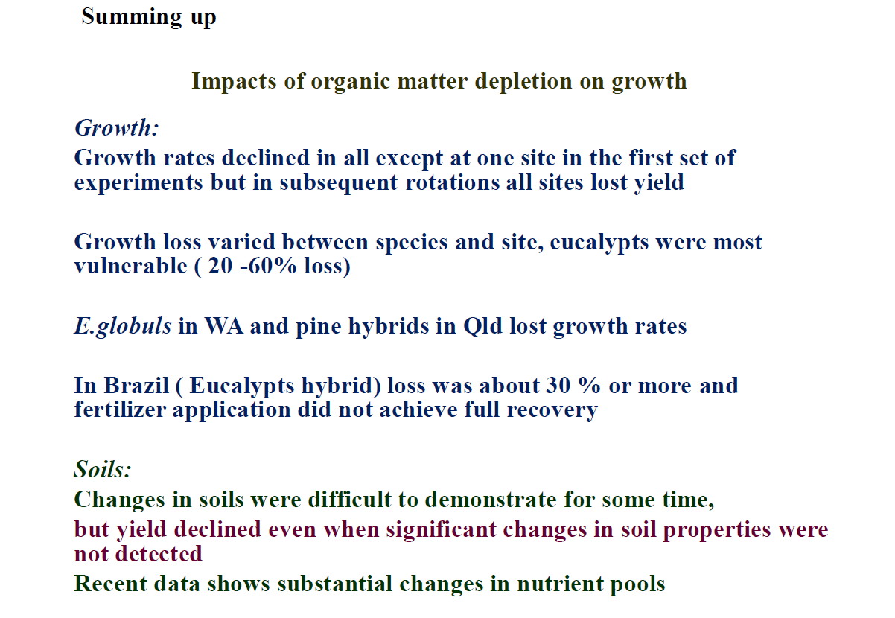
Notes:
13

Slide 14
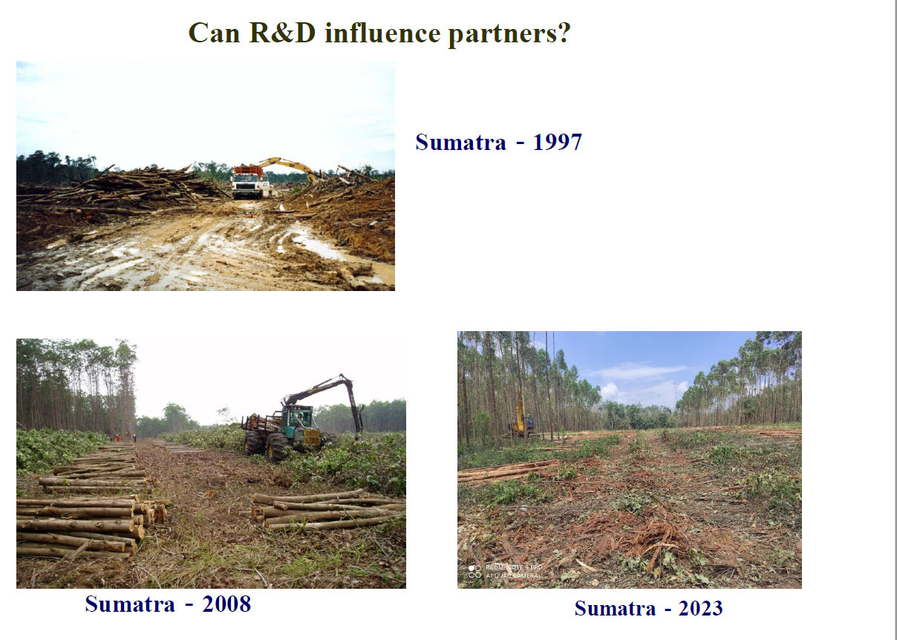
Notes:
14

Slide 15
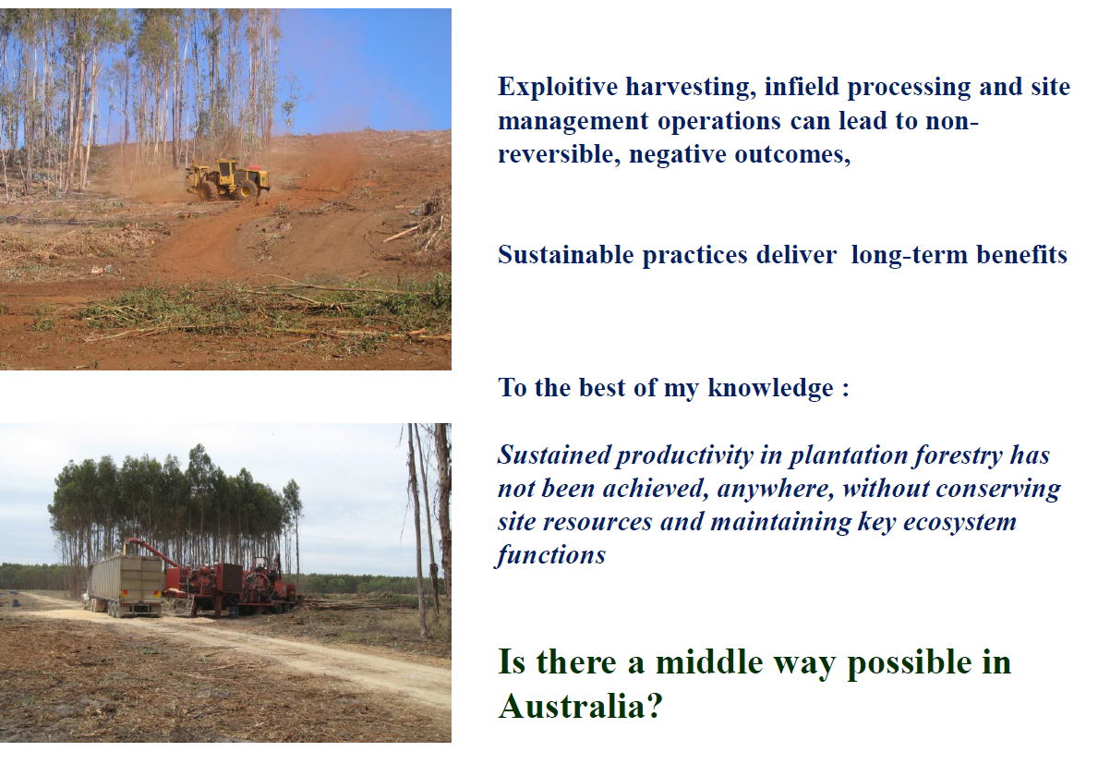
Notes:
15

Slide 16
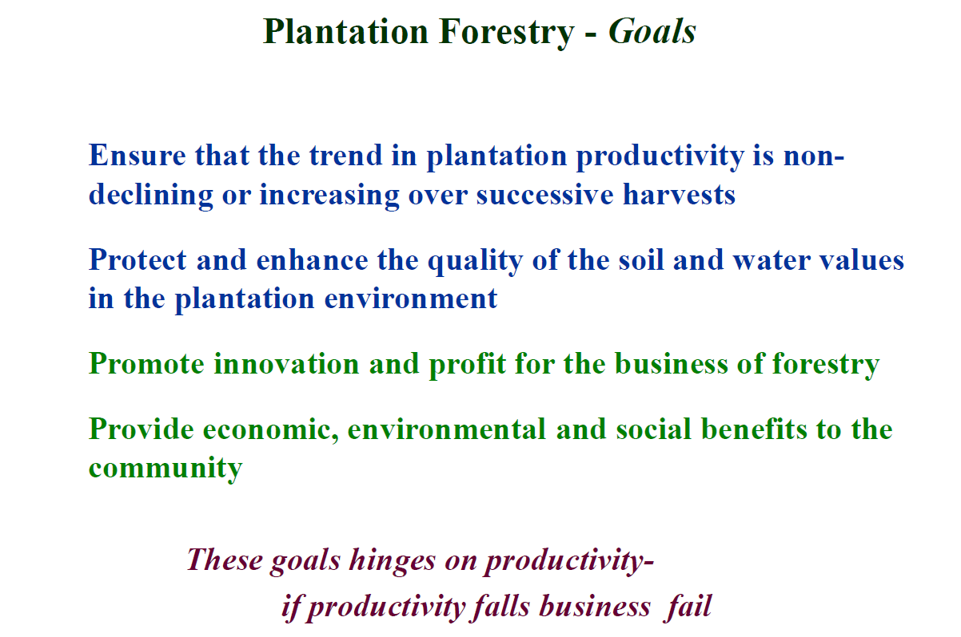
Notes:
16

Slide 17
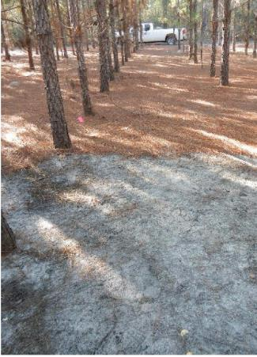


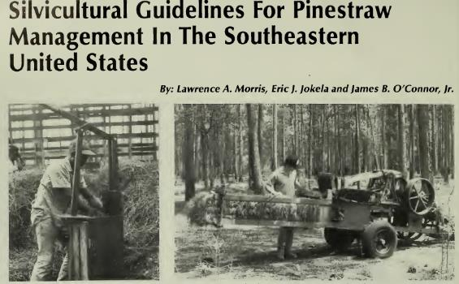
Litter Raking
Observed in 1876 to cause decline in forest productivity in Germany – origin of forest nutrition as a discipline – we’ve learnt a lot since
Potentially the moist serious form of biomass harvesting due to high nutrient export
Managed in the south-eastern USA since 1990s in pine plantations – some with annual litter harvesting
Fertiliser inputs essential and guidelines available - including periodic 200 kg N/ha + P, K etc
Nutrient export replacement rates appear inadequate.
Early concerns re. other risks (drought, disease and mortality) only experienced in a few cases.
Fertiliser costs need to be included in economic analyses for proposed biomass removal systems.
General impression is that the industry is managing the risks.

Slide 18
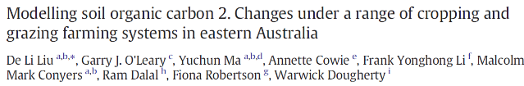
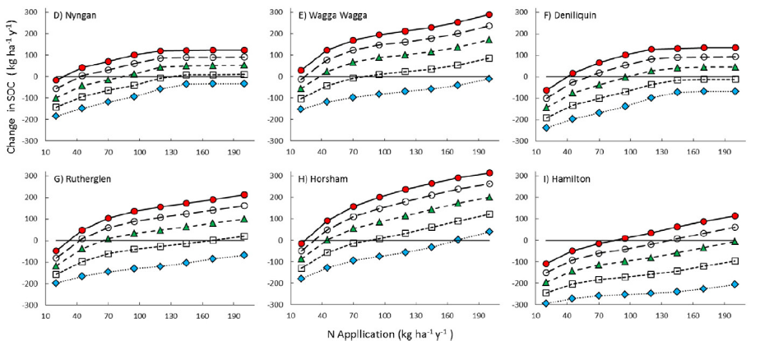

Long-Term Agricultural Residue and Fertiliser Management Studies
Agriculture has several long-term studies that document the effects of residue and fertiliser management on soil properties and food production.
General message is that high fertiliser inputs lead to higher soil C and food production, and more so with residue retention.
Simulation (modelling) capabilities validated at these sites provide confidence in simulations at untested sites and for untested managements and climates.

Slide 19
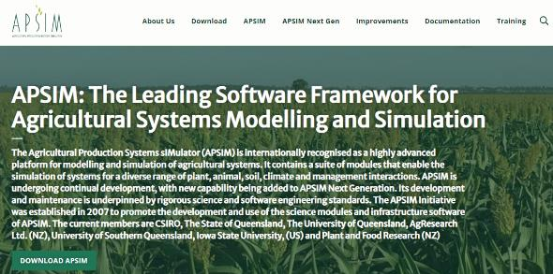
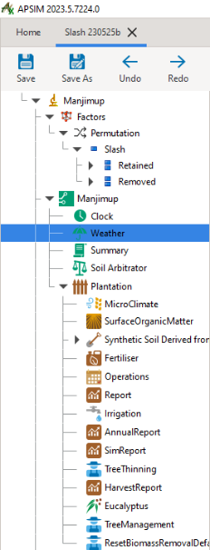

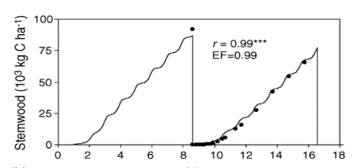
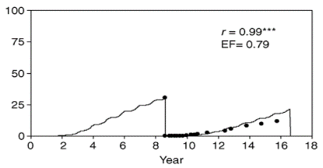
APSIM Modelling Framework for Plantation Forestry
Models for Eucalyptus and Pinus plantations
Already proven useful in various contexts, e.g. yield gap analysis, NO₃ uptake from aquifers
Existing FWPA project will examine slash management effects
- test at Manjimup and Busselton sites for eucalypts for effects of residue retention and fertiliser on soil C and wood production
- apply to new site-management-climate contexts and multiple rotations
More Australian long-term experiments highly desirable for other eucalypt and pine contexts.
Commercial services available
Earlier G’Day modelling indicated that single slash retention is not enough to maintain productivity even on the best sites
(Corbeels et al. 2005)

Slide 20

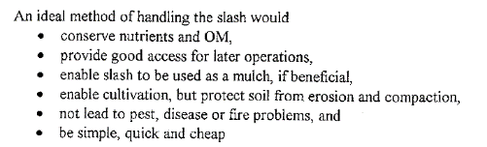
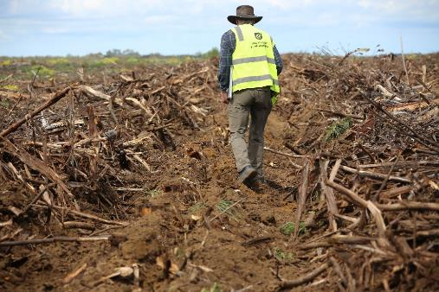
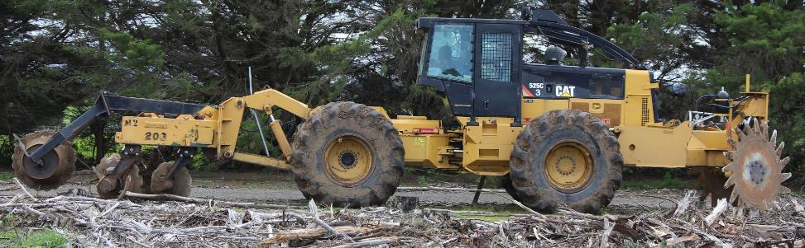
Dealing With Practicalities
Is chopper-rolling still in widespread use for pines?
‘Pine’ chopper rollers were not effective enough handling eucalypt slash – mainly bark strips and springy woody top and branch problems.
Large woody pieces and long strips of bark hamper mechanical handling.
1998 workshop identified attributes of an ideal method
Renewed interest in developing and testing equipment – Clear-Strip system (Jenkin, Desbiolles and O’Hehir - UniSA)

Slide 21
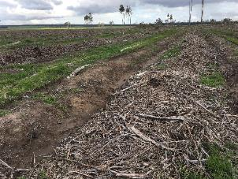
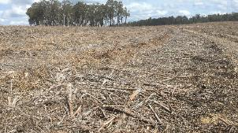
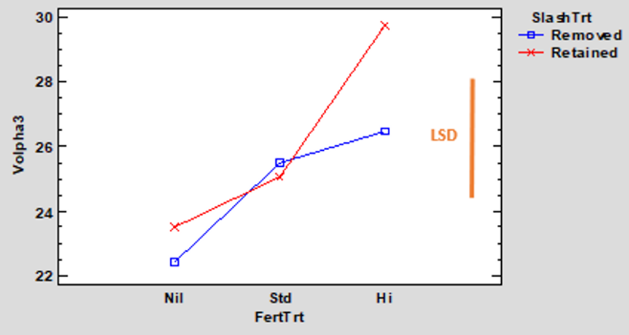
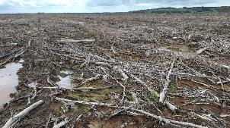
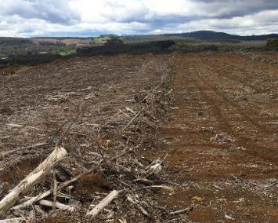
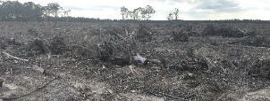
Operational Slash x Fertilizer Experiments Underway
8 sites (WA, Vic, Tas)
Insignificant retain vs remove slash effect at age 3 years, but experimental design issues
Standard fertiliser (16 N: 9 P: 25 K g/tree) x2 (Hi) did not maximise growth (Volpha3)
Response to 200 kg N/ha at 2-3 years 1-50% by 5-6 years of age
FWPA report soon available: McGrath et al “Optimising Nutrition Management of Hardwood Plantations for Sustainable Productivity and Profitability”

Slide 22
Key Points
Biomass removal of fine residues (foliage and small branches) risks productivity and therefore certification.
It’s probably manageable to a large extent with fertilisation.
Fertiliser costs must be included in biomass removal proposals.
Further research and modelling are needed in the Australian context.
APSIM modelling framework is an option already in use in the industry.
Removal of only top wood and branches is a lower risk option.
There are practical options for managing fine and some woody residues.

Slide 23
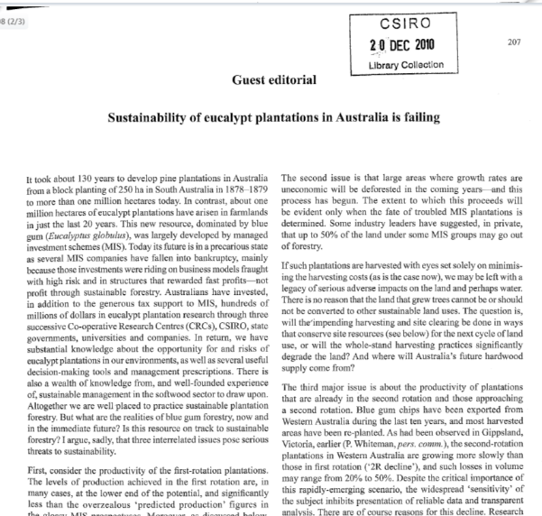
Rotation Optimization Tool - Development
Harvest residues can be a feedstock for renewable energy/fuel production, or retained on site to maintain site productive capacity
BUT
  How to make this decision?
The Rotation Optimisation Tool aims to assist managers to make decisions around:
  Harvesting method
  retention/use of harvest residues
  Fertiliser
  Re-establishment technique
Nambiar, E. K. S. (2010). Sustainability of Eucalypt Plantations in Australia is Failing. Australian Forestry, 73, 207–208.
Notes:
23

Slide 24
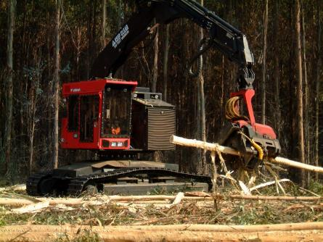
Rotation optimisation tool
Acknowledges that decisions made at harvest impact on next rotation
Aim: To integrate information around harvesting and 2nd rotation productivity and assess impacts on productivity and profitability

Slide 25
Nutrients in slash
Slash contains substantial quantities of nutrients.
  Typically more than in the wood
  N > 200 kg/ha
  P > 10 kg/ha
  Ca typically 200-600 kg/ha
N especially prone to site loss if slash removed or burnt (volatilisation)
Residue management impacts on how much of this nutrient capital remains on site

Slide 26
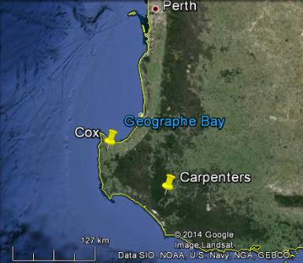
Productivity response to slash management
2 key sites were studied over 3 rotations – Cox and Carpenters
Key message is that slash is important:
  even highly productive sites are responsive to slash retention in 3rd rotation
  Response at both sites is not just to N – other nutrients are important, probably cations
Response to slash and N fertilizer
* Mendham, D. S., Ogden, G. N., Short, T., O’Connell, A. M., Grove, T. S. & Rance, S. J. (2014). Repeated harvest residue removal reduces E. globulus productivity in the 3rd rotation in south-western Australia. Forest Ecology and Management, 329, 279–286.

Slide 27
Key Inputs to the tool
Harvesting method | Cost loaded onto truck | Proportion of slash left in situ
CTL - 2 machine | $30.62 ($3.06) | 1.00 (0.00)
CTL with 50% biomass recovery | $36.74 ($3.67) | 0.50 (0.10)
IFC with separate debarking/delimbing | $31.33 ($3.13) | 0.11 (0.02)
IFC with integrated debarking/delimbing | $23.74 ($2.37) | 0.07 (0.01)
Whole tree on truck | $32.12 ($3.21) | 0.13 (0.03)
Harvest method
  (Ghaffariyan et al. 2012)
Option | Cost to collect slash ($/tonne) | Retention of:
 |  | DW, N & S | P | Ca | Mg | K
Retain in-situ | $0.00 ($0.00) | 1.0 (0.2) | 1.0 (0.2) | 1.0 (0.2) | 1.0 (0.2) | 1.0 (0.2)
Retain and Burn | $10.00 ($2.00) | 0.1 (0.0) | 0.5 (0.1) | 0.5 (0.1) | 0.5 (0.1) | 0.4 (0.1)
Bundling then Burning | $67.30 ($13.46) | 0.0 (0.0) | 0.2 (0.0) | 0.2 (0.0) | 0.2 (0.0) | 0.2 (0.0)
Raking +Bundling then burning | $35.70 ($7.14) | 0.0 (0.0) | 0.2 (0.0) | 0.2 (0.0) | 0.2 (0.0) | 0.2 (0.0)
bundling with no burning | $57.30 ($11.46) | 0.6 (0.1) | 0.6 (0.1) | 0.6 (0.1) | 0.6 (0.1) | 0.6 (0.1)
Raking+bundling with no burning | $25.70 ($5.14) | 0.6 (0.1) | 0.6 (0.1) | 0.6 (0.1) | 0.6 (0.1) | 0.6 (0.1)
Slash management
(costs from Ghaffariyan and Andorovski , 2011)
Option | Cost year 0 (site prep.) | Cost year 1 (planting) | Cost year 2 (reduction) | Impact on productivity (proportion)
Coppice | $0 | $0 | $500 ($50) | 0.9 (0.1)
Rip and replant (V-blade) | $500 ($50) | $500 ($50) | $0 | 1.0 (0.1)
Remound and plant | $300 ($30) | $500 ($50) | $0 | 1.0 (0.1)
Re-establishment
(estimated costs and effects)

Slide 28
Outputs from case studies
The tool was applied to 4 hypothetical case study sites
  Rocky Gully, Manjimup, Busselton, Albany
Case studies explored impacts of:
  Harvest method
  Slash management and site preparation
  Re-establishment method
General assumptions included:
  End of the 2nd rotation, and into 3rd rotation
  log value was $100/m³ at the port
  harvest residue sale value was $20/dry tonne at farm gate
  loading cost for harvest residues was $5/dry tonne
  Slash redistribution costs (from pile to site) were $10/dry tonne

Slide 29
Impacts of harvest method
No impact of harvest method on productivity (because full nutrient replacement is assumed)
Cut to length gave higher NPV then in-field chipping
In field chipping with redistribution of residues gave the lowest NPV and IRR

Slide 30
Predicted impacts of residue manipulation
No significant impact on predicted productivity (as full nutrient replacement assumed)
Financially better off to retain residues then to burn or sell them

Slide 31
Predicted impact of fertilizer
Fertilizer had a big impact on productivity and NPV
Lower impact on IRR, especially at low productivity sites

Slide 32
Predicted impact of re-establishment method
Coppice had lower predicted productivity, but similar NPV and IRR
Seedlings into unburnt slash had higher predicted NPV
Seedlings with slash burnt had similar NPV to coppice, but lower IRR because of the up-front costs.

Slide 33
Conclusions
The Rotation Optimisation Tool offers a means for plantation managers to explore the costs, benefits and productivity implications of management choices around harvest
Inputs are transparent and up to the user to input
Hypothetical case studies showed that cut to length harvesting with slash retained at site tended to be the best option for both productivity and profitability

